Slide 1
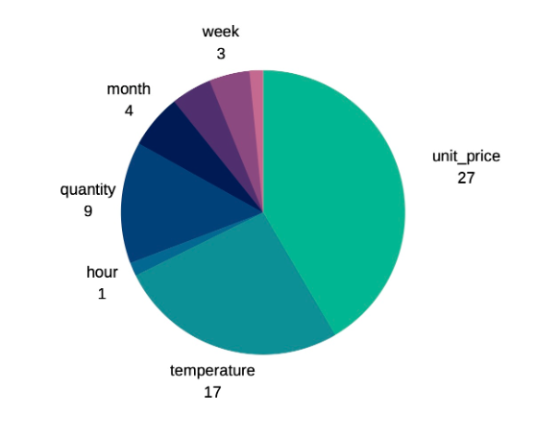
Relative importance of features

Slide 2
More data is required
Approximately 50% accuracy with the current set of data and features that were created. In order to test this model for production, we need larger samples.
Price is important
Price was an important feature in the model, but category was not.
Are there more features about the products that we can use to include in the model?
Build on loT.
Temperature was also significant within the model, with more loT data across a larger time period, we believe the accuracy of this model will increase. It also opens up the potential to use open source data, such as weather.

